Slide 1
DELE CA1 Part A
By Davian

Slide 2
Overview Of The Workflow
Exploratory data analysis
Creating the model
Conclusion
Model Improvement

Slide 3
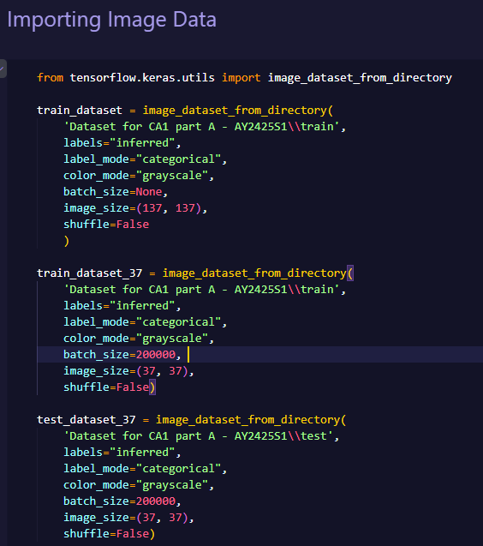
Importing Image Data
image_dataset_from_directory from the keras utils was used to import the image data. It was also used to reshape the image size, greyscale it, and one hot encode the labels

Slide 4
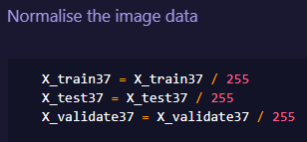
Image normalization
We normalize the image data by dividing it by 255 to help enhance the performance of image classification models

Slide 5
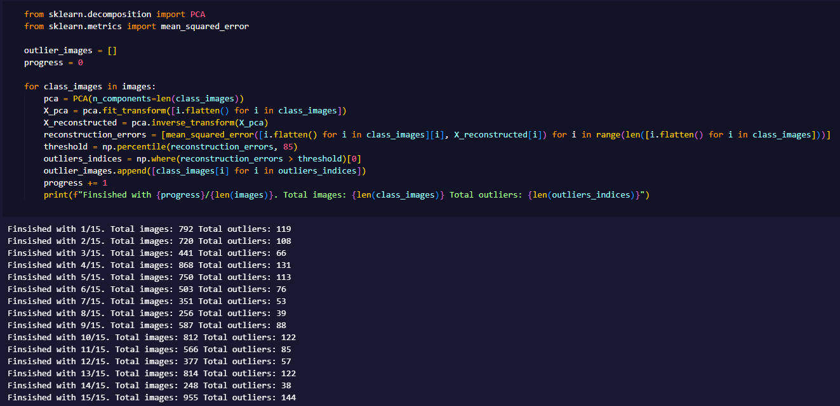
Exploratory Data Analysis
After manually checking through the dataset and manually removing data which isn't supposed to belong to a class (i.e., carrots in beans), doing PCA can help us to 'double-check' if we have gotten all the misplaced data.

Slide 6
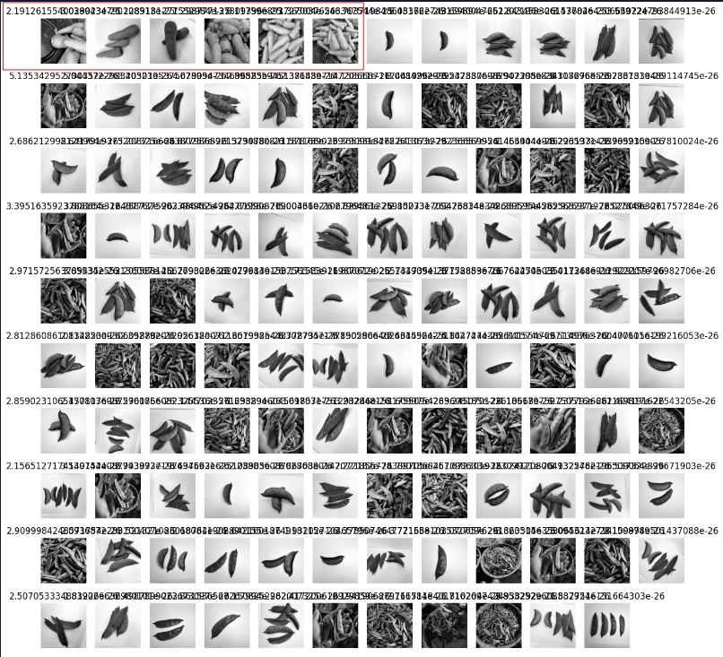
Exploratory Data Analysis
For the bean dataset, the PCA has helped to detect some carrots which I missed out as outliers.

Slide 7
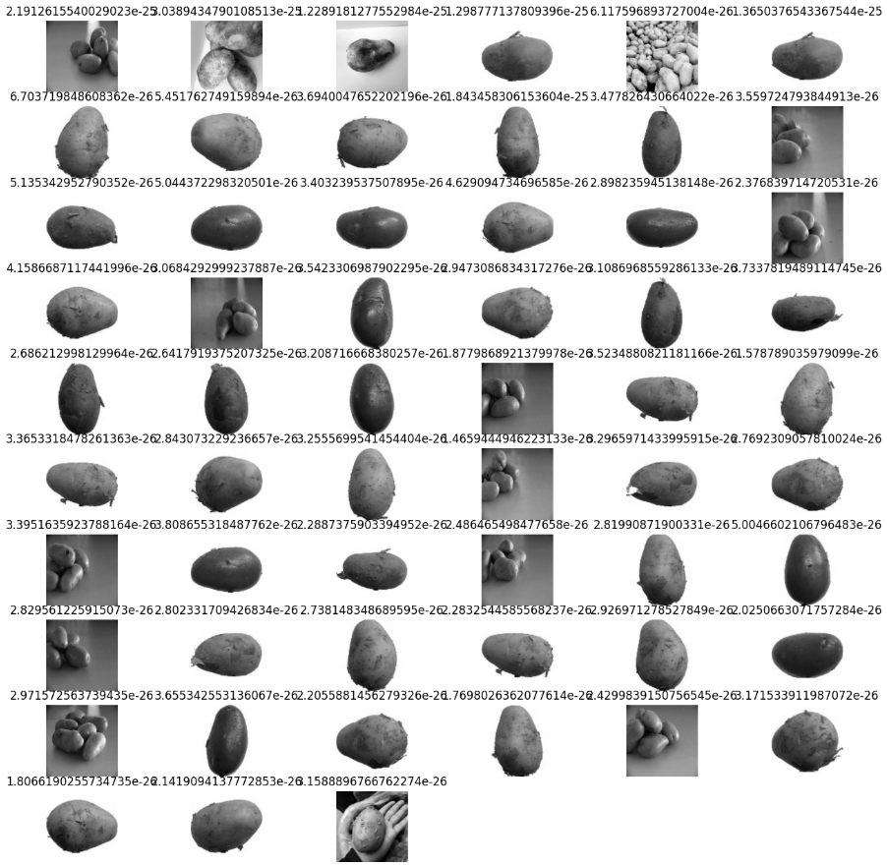
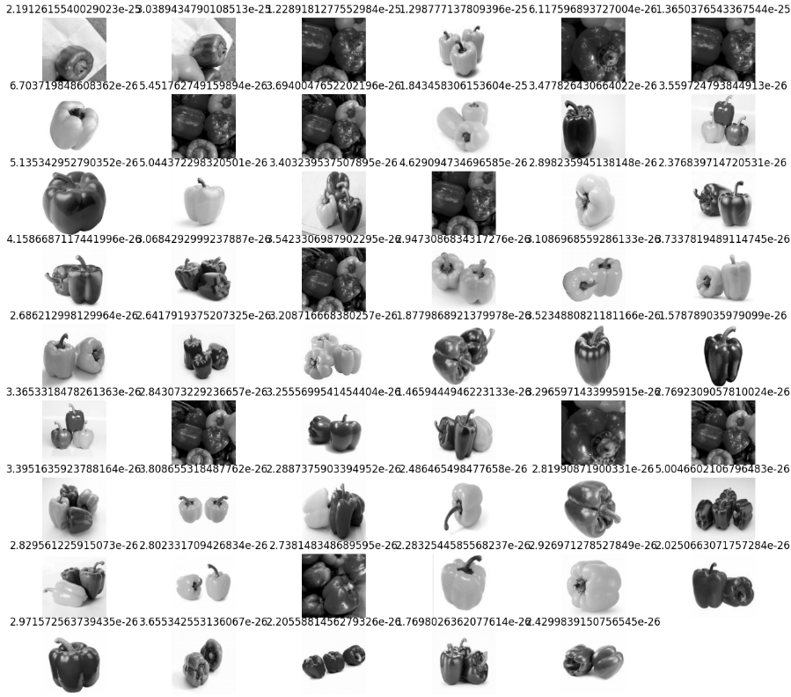
Exploratory Data Analysis
PCA can also aid in data exploration for the dataset. For some datasets like potato and capsicum, most of the images PCA has picked out are those with a very light background.
I won't remove those outliers as the images in the train and validation dataset have the same type of images.

Slide 8
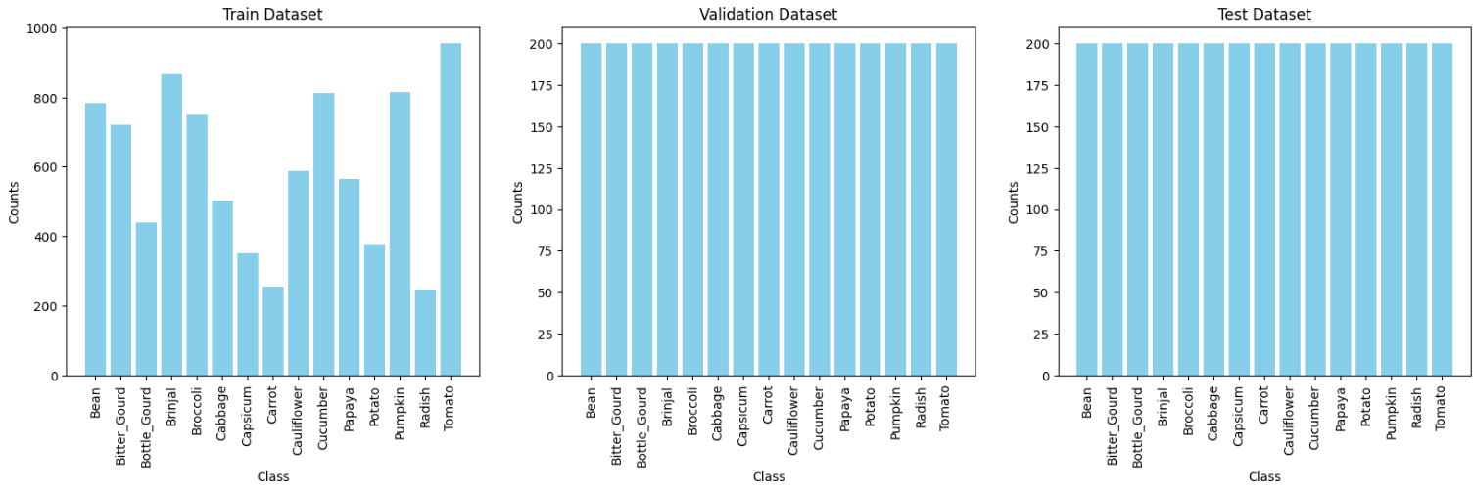
Checking dataset class balance
As you can see, there are class imbalances in the train dataset only. Carrot and Radish has the lowest number of images in its dataset.
We can use data augmentation to help fix the class imbalance by creating more training data for classes with lower image data. However, I did not do it due to time constraint.

Slide 9
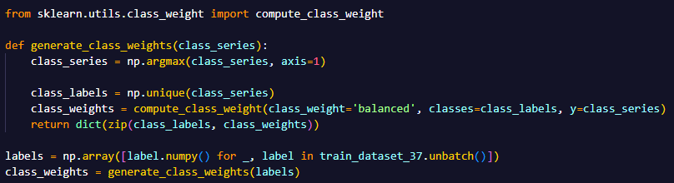
Calculating Class Weights
To help counter the class imbalance, we will use class weights when fitting the models.

Slide 10
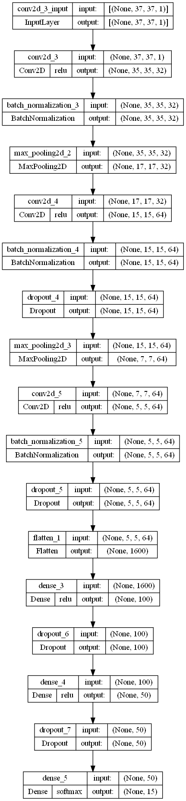
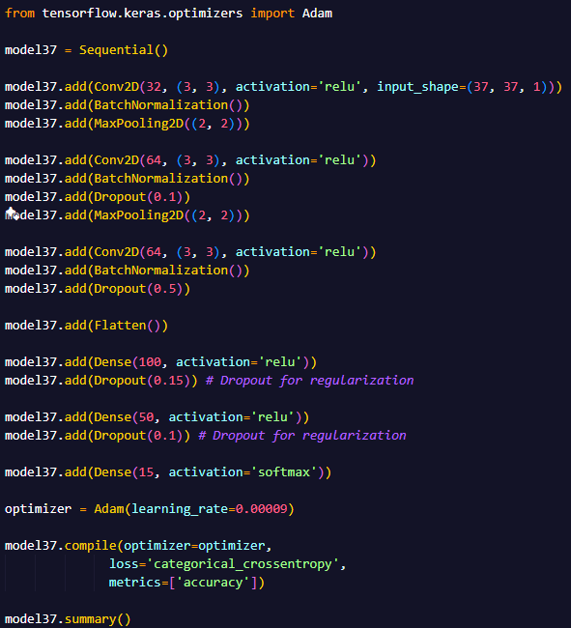
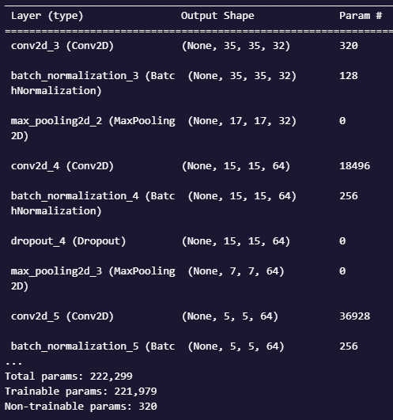
37x37 Model
To improve the model, I added dropout to prevent overfitting, added BatchNormalization between layers to stabilize the distributions of layer inputs and MaxPooling2D to downsample the data and extract the most important information.
The learning rate of Adam was set to 0.00009 to help reduce volatility in the loss and accuracy scores.
This model has a total of 221,979 trainable parameters

Slide 11
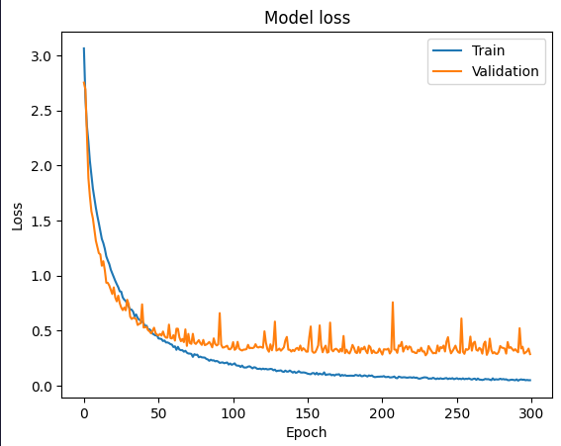
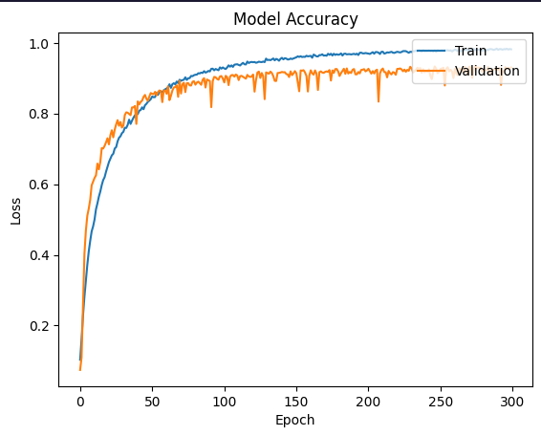
37x37 Model
From the model loss graph, there is no overfitting of the model onto the training data.

Slide 12
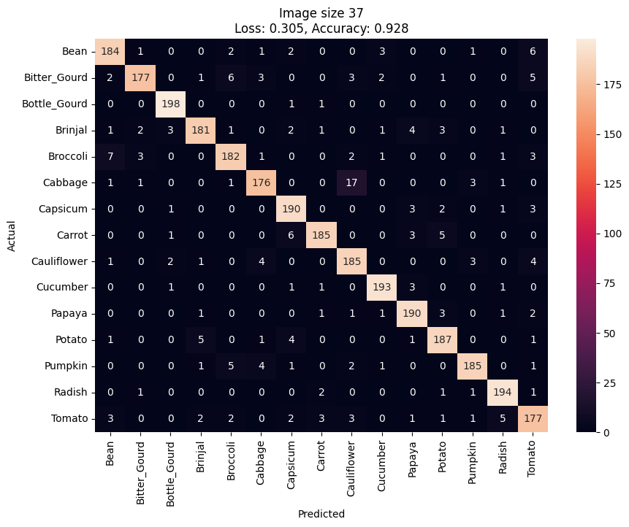
37x37 Model
The 37x37 Model has a loss of 0.305 and an accuracy of 92.8% when tested on the testing data.
From the confusion matrix, you can see that the model doesn’t do so well on predicting cabbages as 17 cabbages were classified as cauliflower instead.

Slide 13
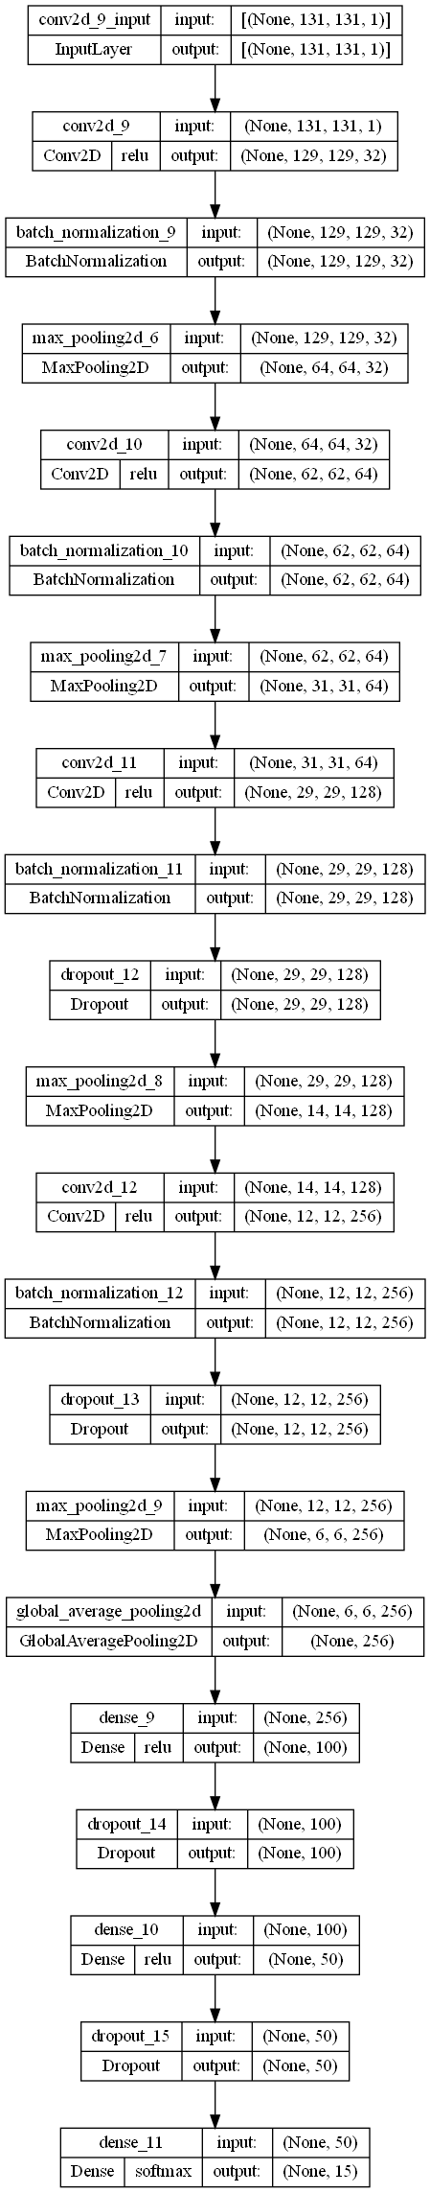
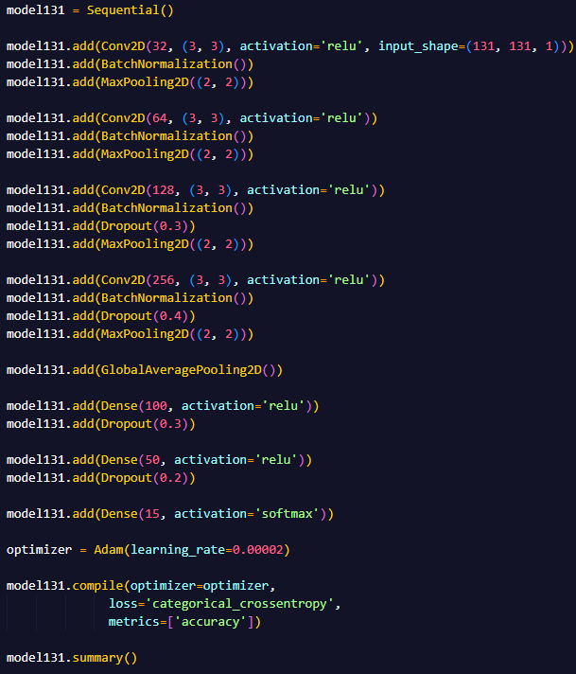
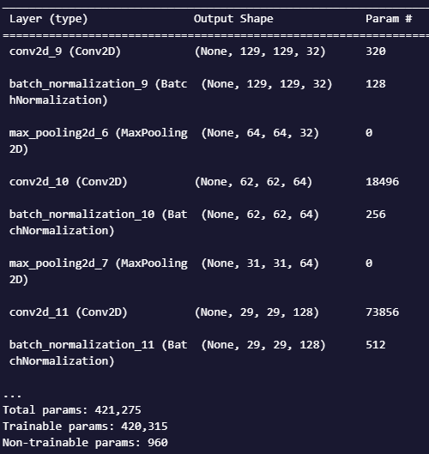
131x131 Model
To improve the model, I added dropout to prevent overfitting, added BatchNormalization between layers to stabilize the distributions of layer inputs and MaxPooling2D to downsample the data and extract the most important information.
More layers were used and there are more neurons compared to the 37x37 model as there is more data to train on.
The learning rate of Adam was set to 0.00002 to help reduce volatility in the loss and accuracy scores.
This model has a total of 420,315 trainable parameters

Slide 14
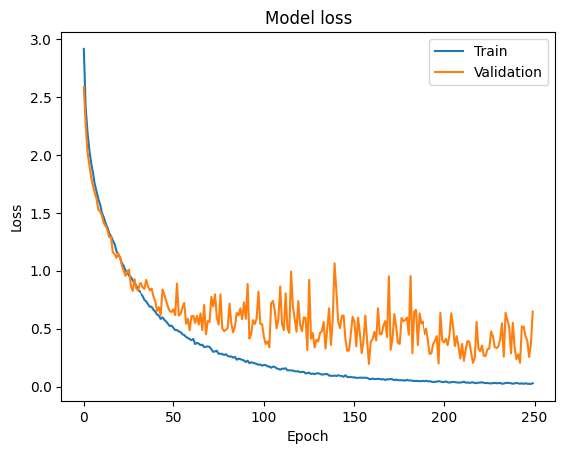
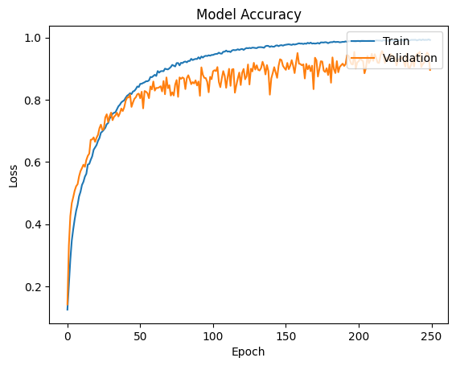
131x131 Model
From the model loss graph, there is no overfitting of the model onto the training data.

Slide 15
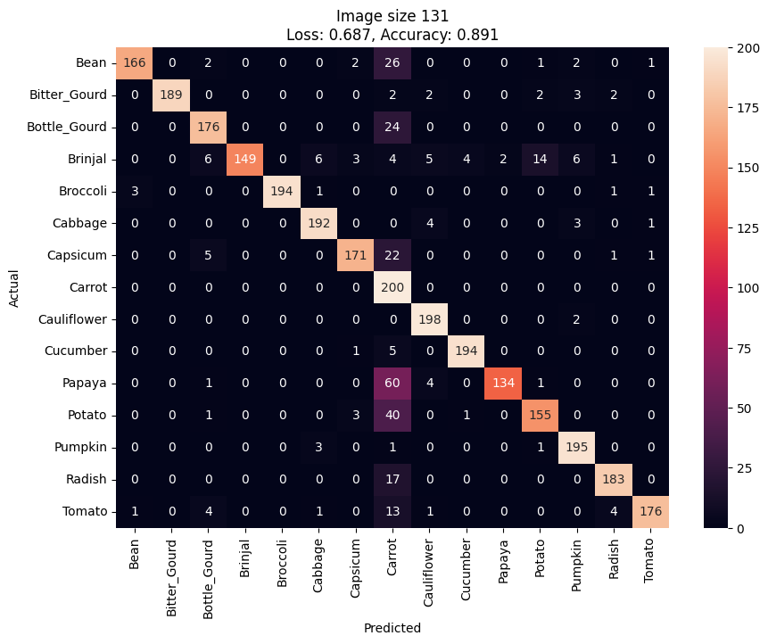
131x131 Model
The 131x131 Model has a loss of 0.687 and an accuracy of 89.1% when tested on the testing data.
From the confusion matrix, you can see that the model misclassifies a lot of data as carrots when it is not with Papaya being the most.

